Slide 1
Twitter Sentiment Analysis
By: Ashvi Soni and Ayush Dwivedi
EMSE 6586 Database Systems for Data Analytics

Slide 2
Overview of the project
In this project, we have done sentiment analysis on a Twitter Dataset.
We did various data analysis as well as data visualizations on the dataset which gives useful insights and answers some questions with respect to data.
Finally, we trained classical Machine learning models to do the predictions on the dataset.

Slide 3
Dataset: Sentiment140
This dataset is called ‘Sentiment140 Dataset’, which is retrieved from Kaggle. (Link: https://www.kaggle.com/kazanova/sentiment140)
This dataset contains 1,048,575(more than 1 million) tweets.
It contains attributes such as userid, username, time, tweet
The negative tweets have output label 0 and positive tweets have output label 4.

Slide 4
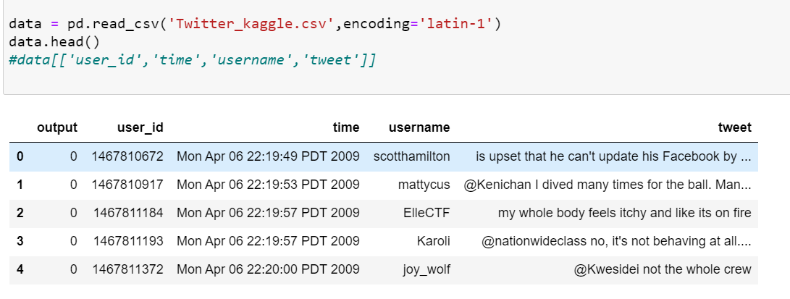
A look at the Dataset

Slide 5
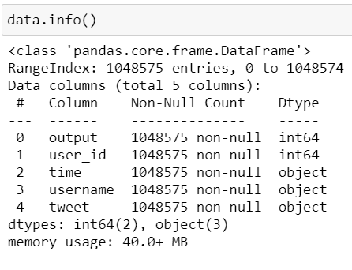
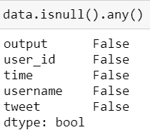
Analysis and Insights
Dataset Info:
Information of the dataset- what columns are there, what are its data types, do they contain null values, if yes then how many.

Slide 6
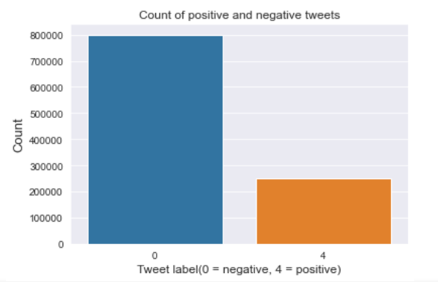
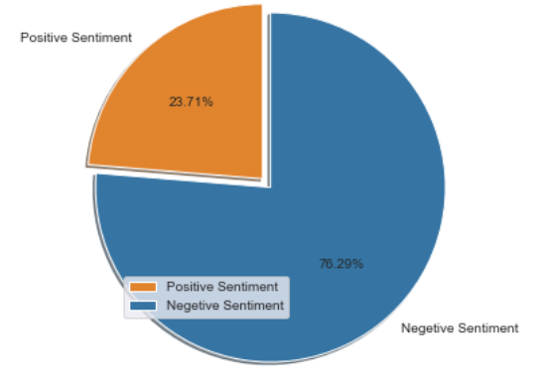
Analysis and Insights
Number of
Positive Vs Negative Tweets:
Positive: 248,576
Negative: 799,999

Slide 7
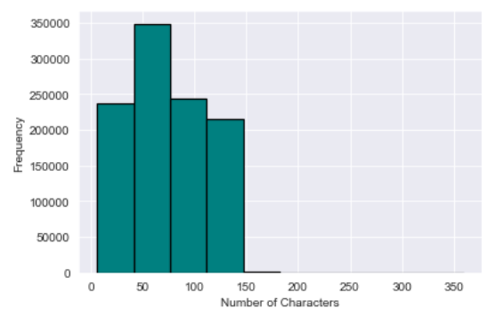
Analysis and Insights
Tweets length distribution:
Few tweets with more than 150 characters
Fewer or no tweets with more than 180 characters(this is an approximation)

Slide 8
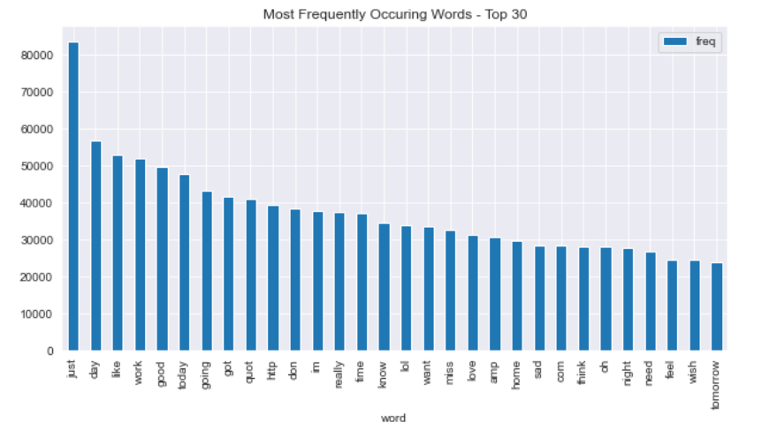
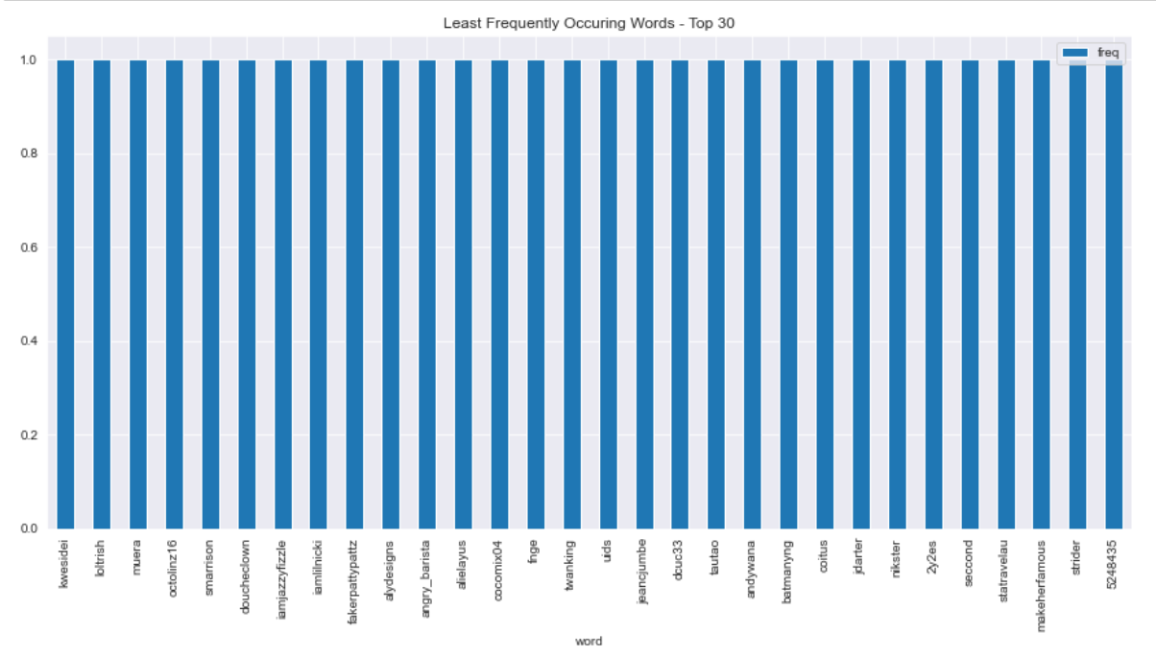
Analysis and Insights
Top 30 most and least frequently occurring words in the dataset:
Removed words like ‘and’, ‘the’, etc.
Most frequent word is ‘Just’.
The least frequent 30 words- all have frequency 1. (‘kwesidei’, ‘loltrish’, etc)

Slide 9
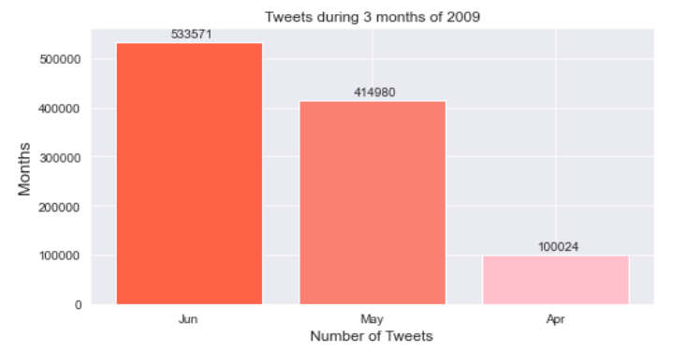
Analysis and Insights
Tweets in each month of 2009:
Our dataset consists of only tweets of 2009 and only tweets during these 3 months.

Slide 10
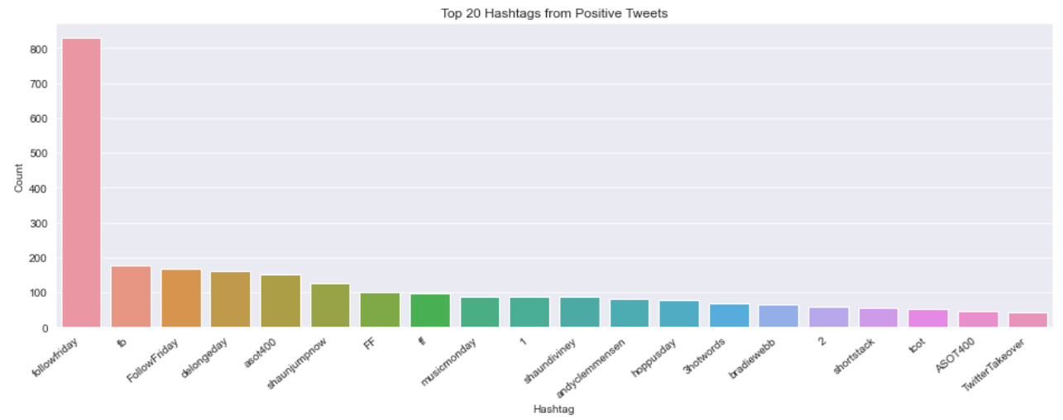
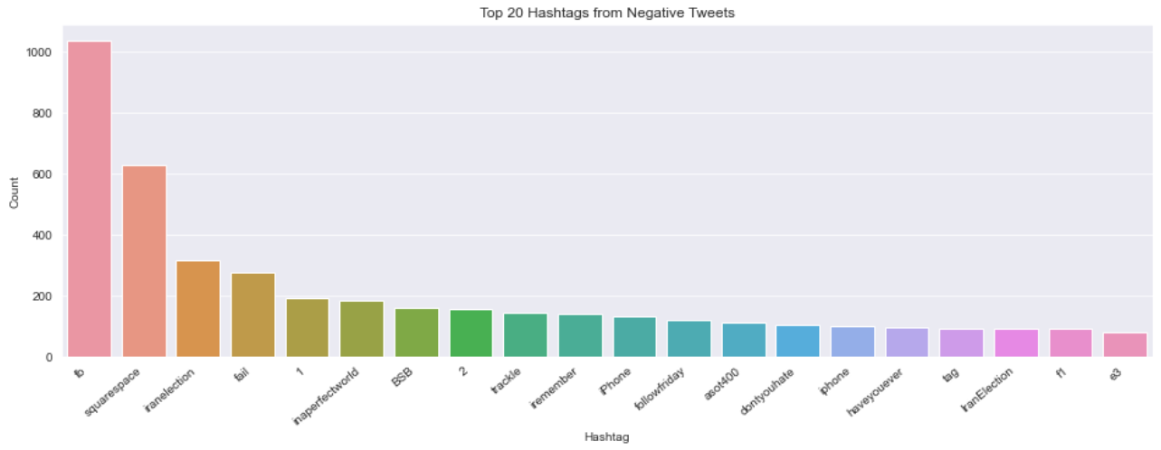
Analysis and Insights
Top 20 frequently occurring Hashtags from positive and negative tweets:
Most frequent hashtag from positive tweets is ‘followfriday’
Most frequent hashtag from negative tweets is ‘fb’

Slide 11
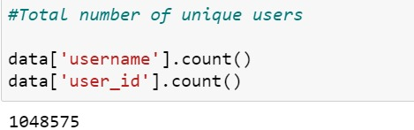
Analysis and Insights
Number of unique users:
We have shown how many unique users were there.
There were 1048575 uniques users

Slide 12
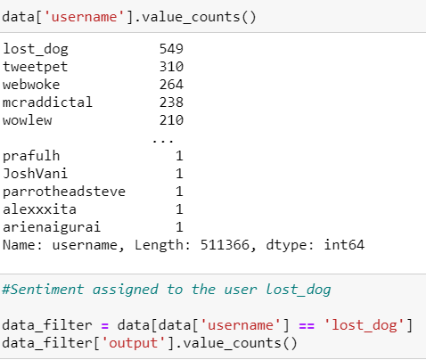
Analysis and Insights
Tweets per user:
Looked at number of tweets by each user.
The user named ‘lost_dog’ has highest number of tweets- 549

Slide 13
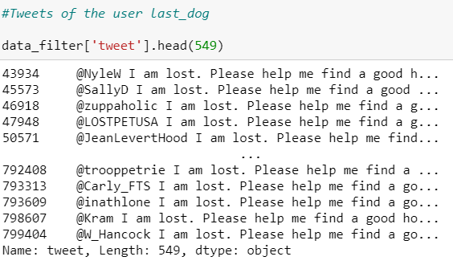
Analysis and Insights
Tweets by the user last_dog:
We have displayed tweets which were tweeted by last_dog.

Slide 14
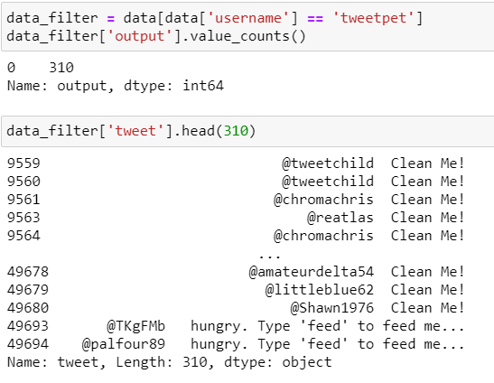
Analysis and Insights
Tweets by the user tweet_pet:
We have displayed tweets which were tweeted by tweet_pet.

Slide 15
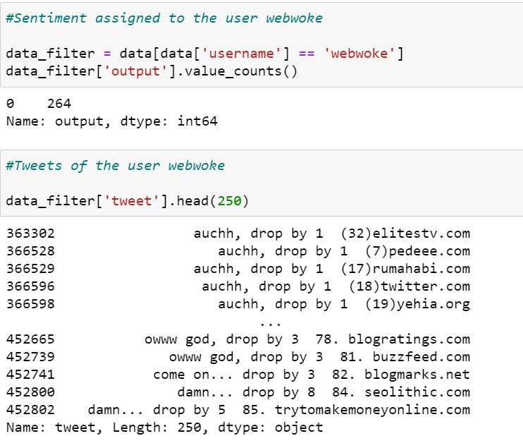
Analysis and Insights
Tweets by the user webwoke:
We have displayed tweets which were tweeted by webwoke.

Slide 16
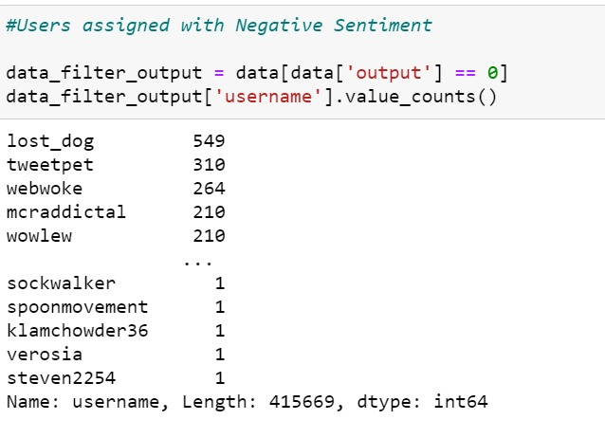
Analysis and Insights
Users associated with negative tweets:
We have displayed the users who are associated with negative tweets.

Slide 17
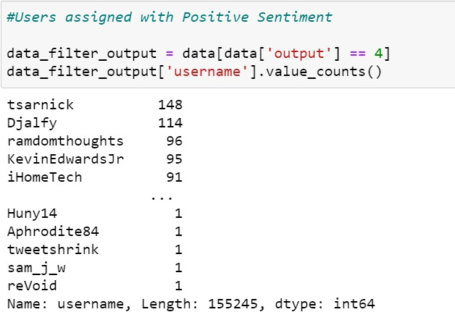
Analysis and Insights
Users associated with positive tweets:
We have displayed the users who are associated with positive tweets.

Slide 18
Preprocessing Tweets
Lowered the strings
Removes usernames(anything followed by @...)
Removed URLs
Removed digits
Removed Emojis
Removes all single characters(eg: a, I, etc)
Removed Punctuations
Replaced double spaces with single space

Slide 19
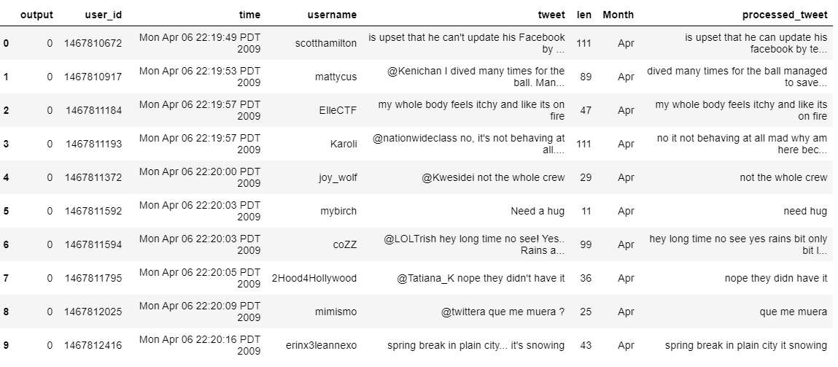
Processed Vs Unprocessed Tweets

Slide 20
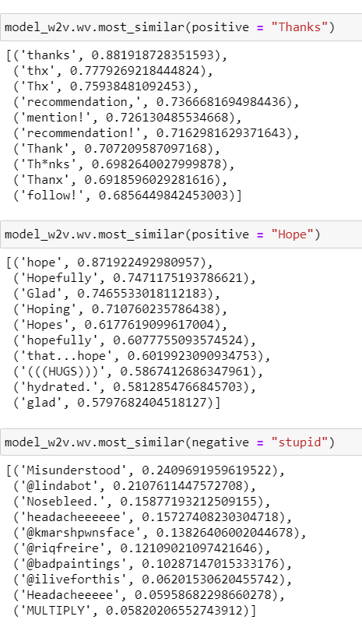
Analysis and Insights
Looking at similar words:
We have looked at the words similar to ‘Thanks’, ‘Hope’, and ‘Stupid’.

Slide 21
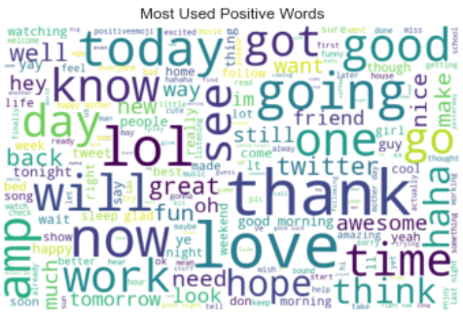
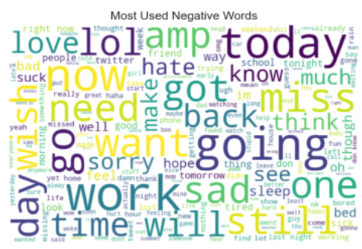
Analysis and Insights
Word Cloud:
Size of each words indicates its frequency.
Most frequently used word in positive tweets is ‘thank’, ‘lol’, ‘love’(by looking at their size)
Most frequently used word in negative tweets is ‘work’,’going’ and ‘today’(by looking at their size)

Slide 22
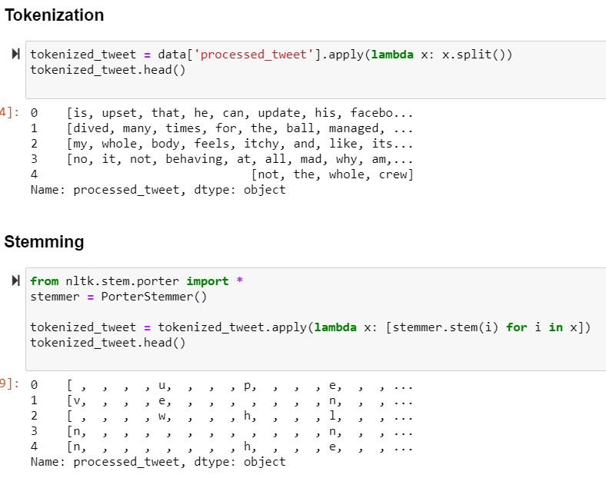
Toeknization
and Stemming
Tokenized processed tweets in distinct words.
Reduced words to its stem

Slide 23
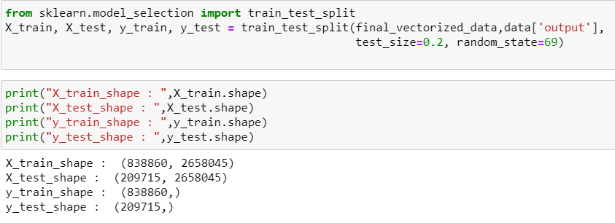
Splitting the Dataset
For Machine Learning models, we have split the dataset into training and testing sets.
Training set: 80%
Test set: 20%

Slide 24
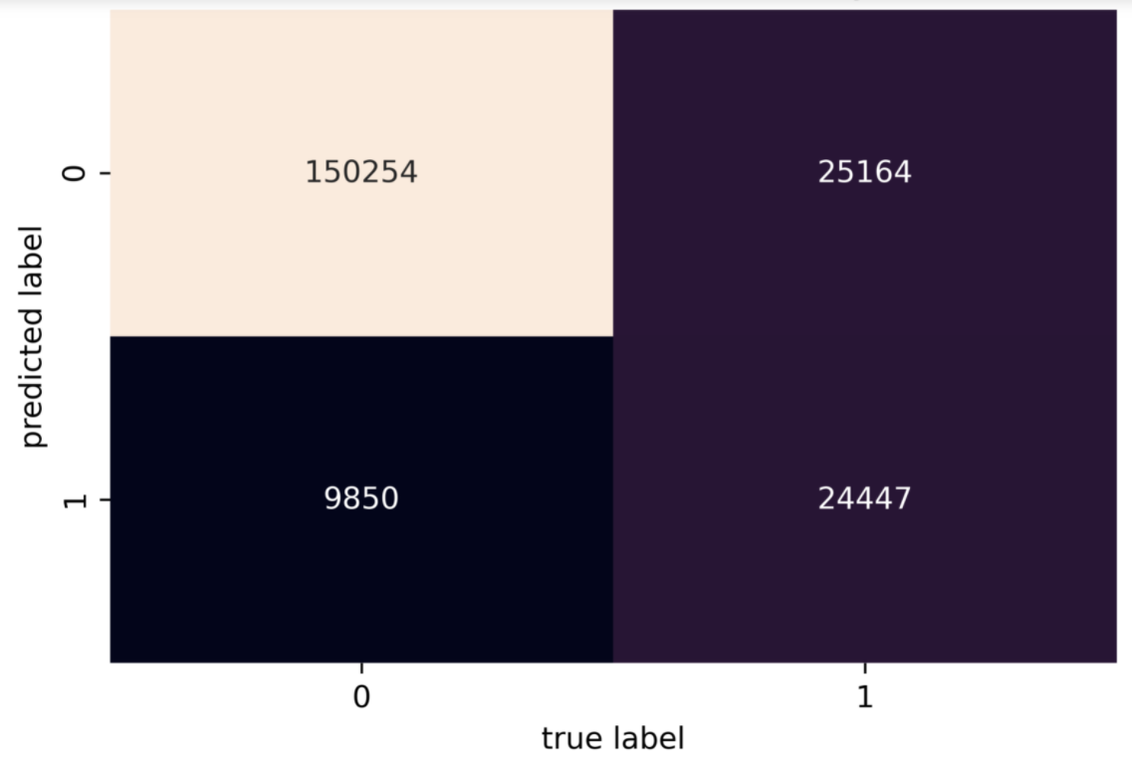
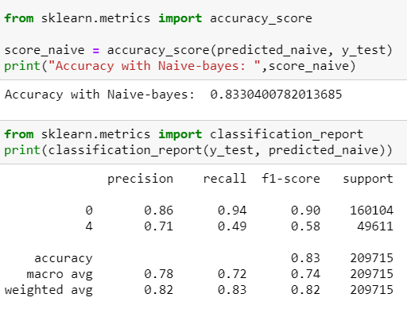
Machine Learning Model:
Naive Bayes
The accuracy of Naive Bayes model is: 0.833

Slide 25
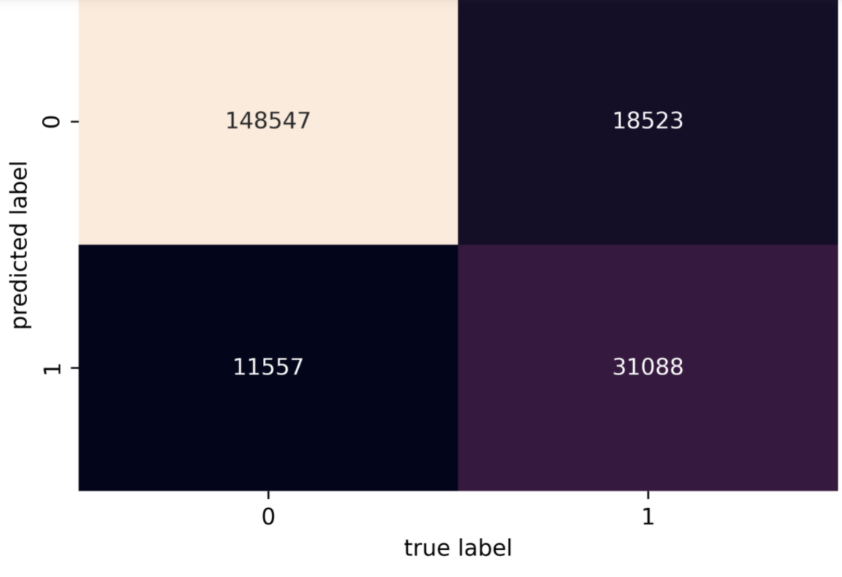
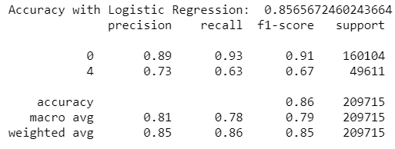
Machine Learning Model:
Logistic Regression
The accuracy of Logistic Regression model is: 0.856

Slide 26
Extended Project
From here the slide show represents the work done in the Second half of the project which incorporates the feedback from Professor Klien.
Now, we are dealing with the data from the Database: ‘EMSE6992’, table: ‘proj_stats’.

Slide 27
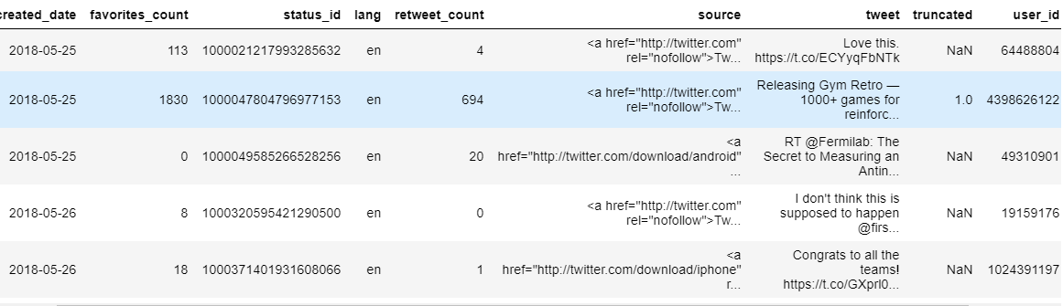
A look at the Dataset

Slide 28
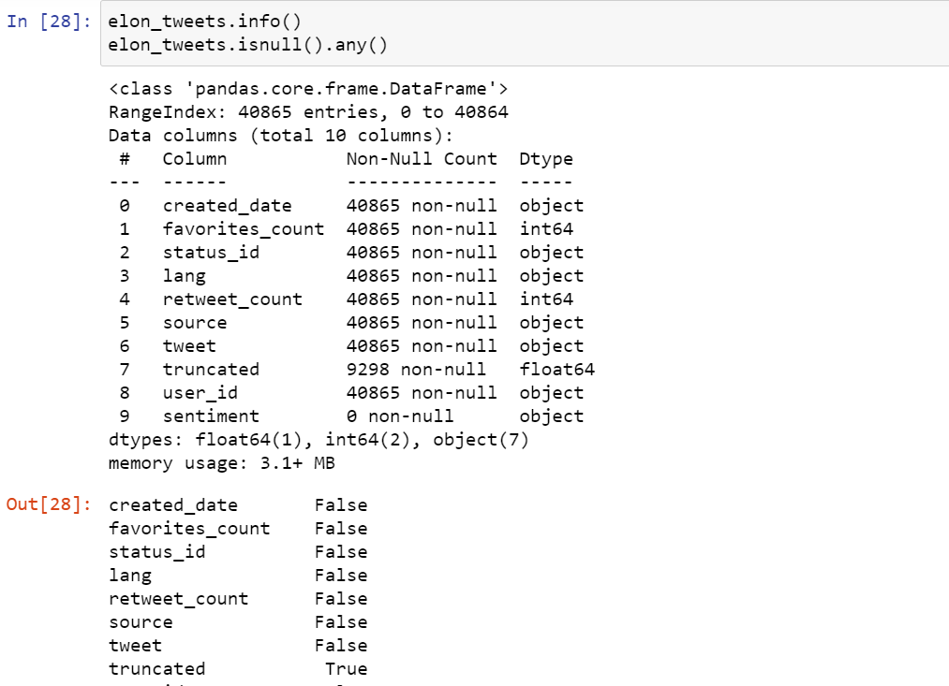
Data Exploration
We started exploring the dataset.

Slide 29
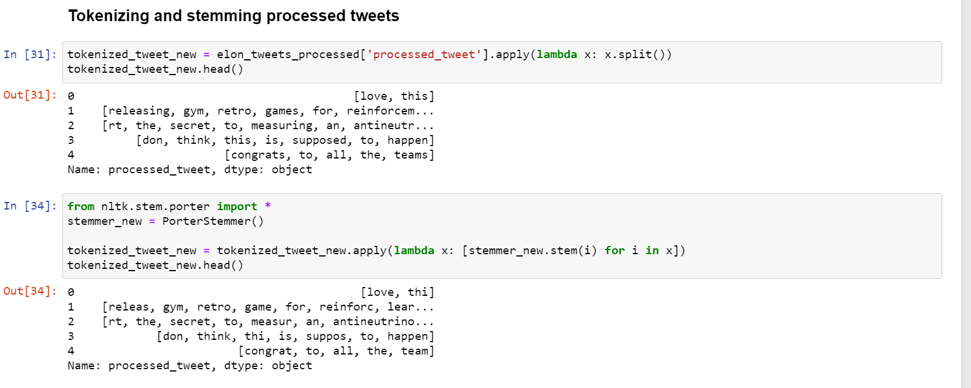
Pre processing of the Dataset

Slide 30
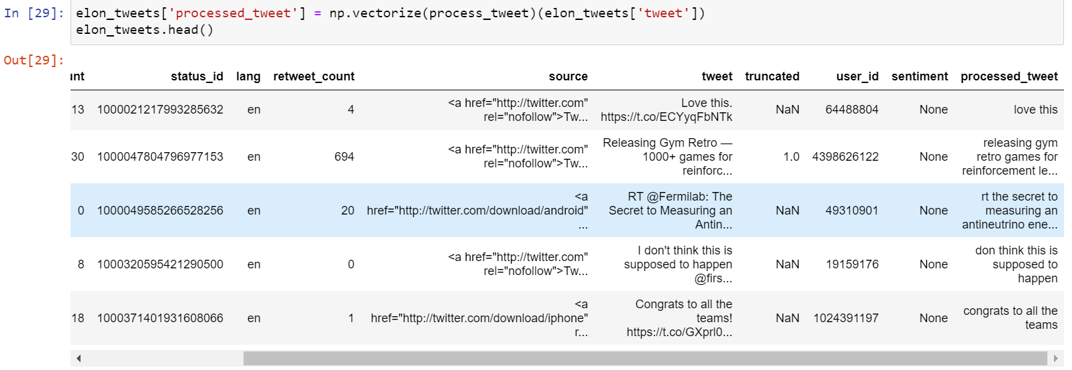
Adding the Processed Tweet column to the main dataset

Slide 31
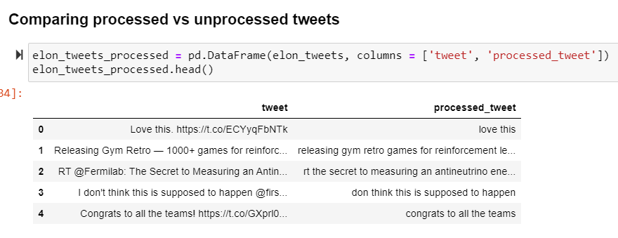
Processed Vs Unprocessed Tweet

Slide 32
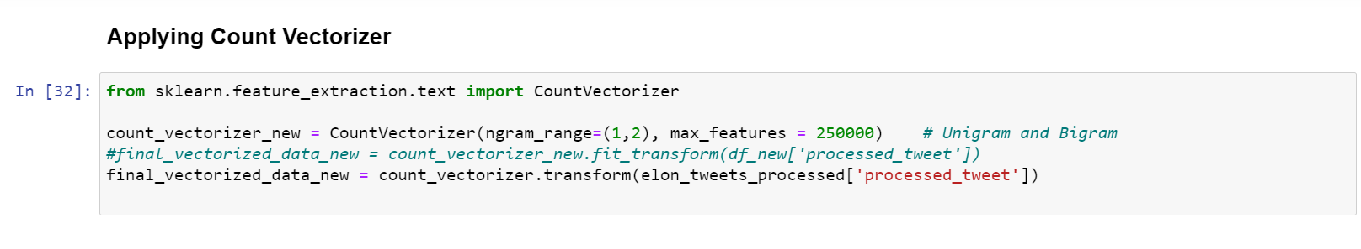
Using Count Vectorizer to create the Feature Space

Slide 33
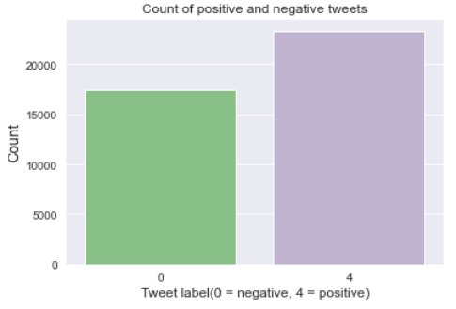
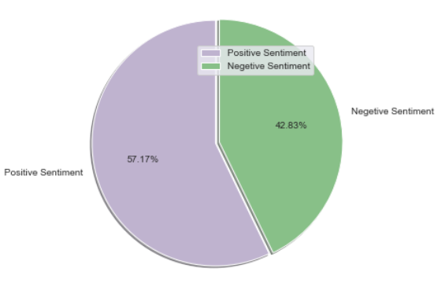
Analysis and Insights
Number of
Positive Vs Negative Tweets:
Positive: 23,364
Negative: 17,501

Slide 34
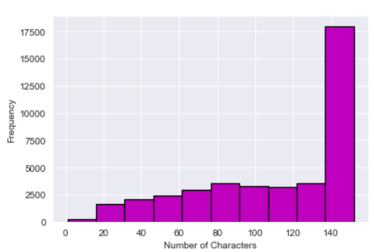
Analysis and Insights
Tweets length distribution:
Few tweets with less than 20 characters .
More than 17,500 tweets with more than or equal to 140 characters.

Slide 35
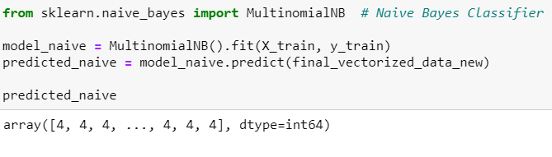
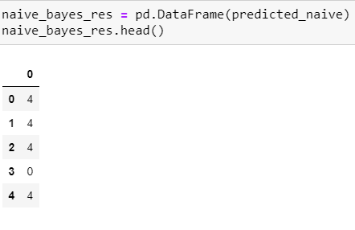
Getting sentiment score through Naive Bayes Model
Naive Bayes Model:
We predicted the scores on Naive Bayes as well as Logistic Regression Model.
For simplicity, we chose to go ahead with Naive Bayes Model.
The predicted scores are as shown

Slide 36
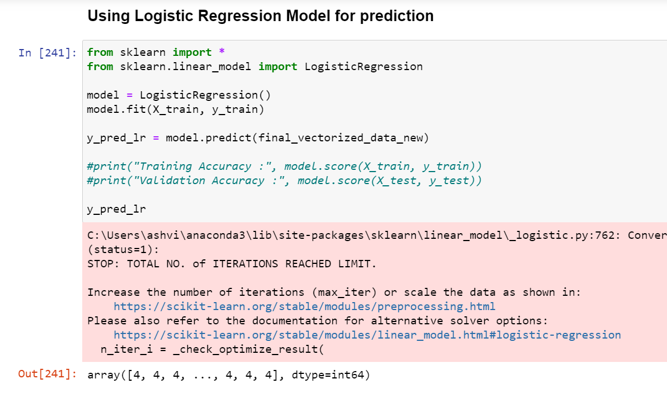
Getting sentiment score through Logistic Regression as well

Slide 37
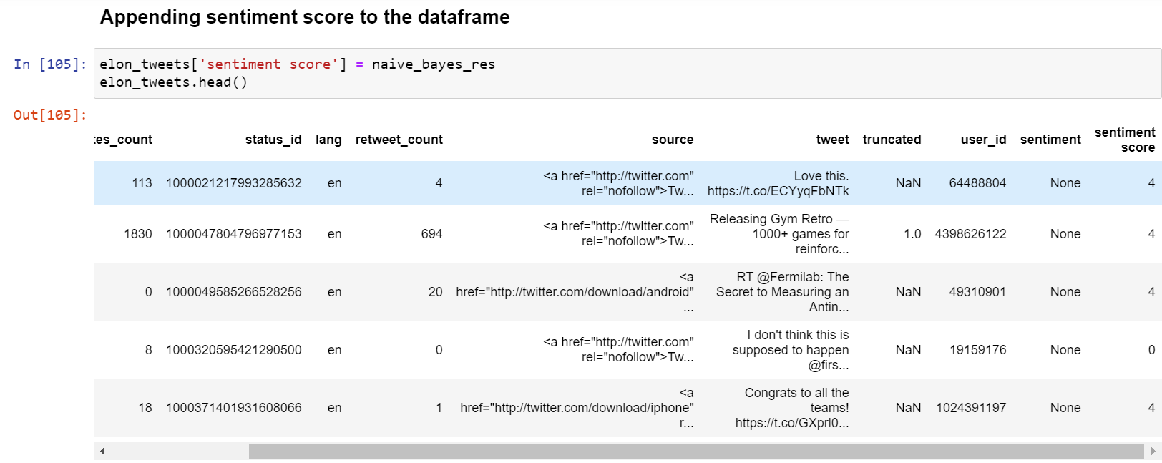
Finally we took the Predictions from Naïve Bayes Model to create the Sentiment Score

Slide 38
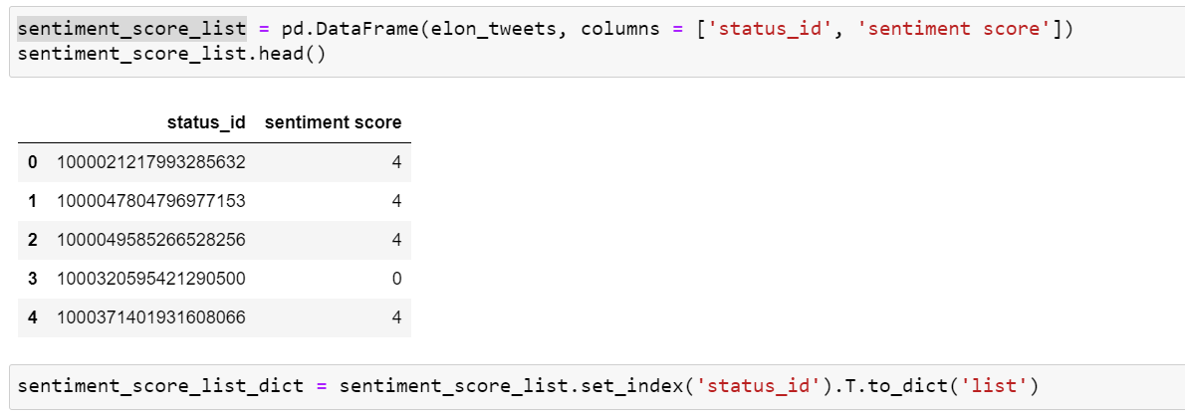
Since Status_ID is unique so we took and created a dictionary with status_id as key and sentiment score as value

Slide 39
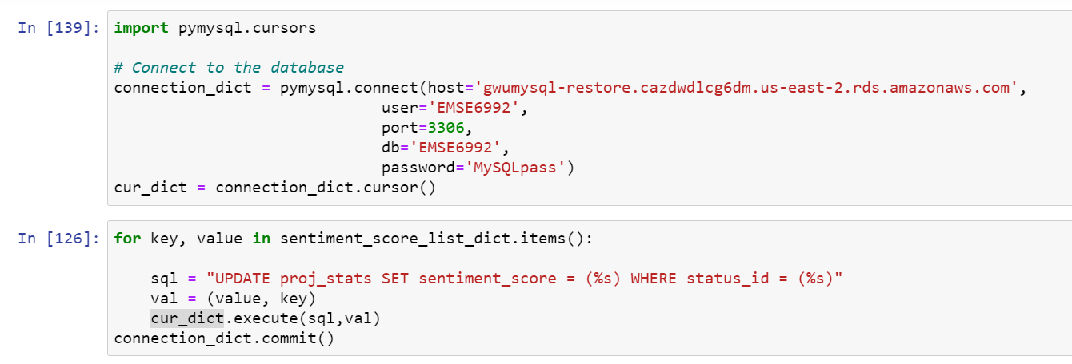
We ran and updated the table in the SQL with an additional Sentiment Score column

Slide 40
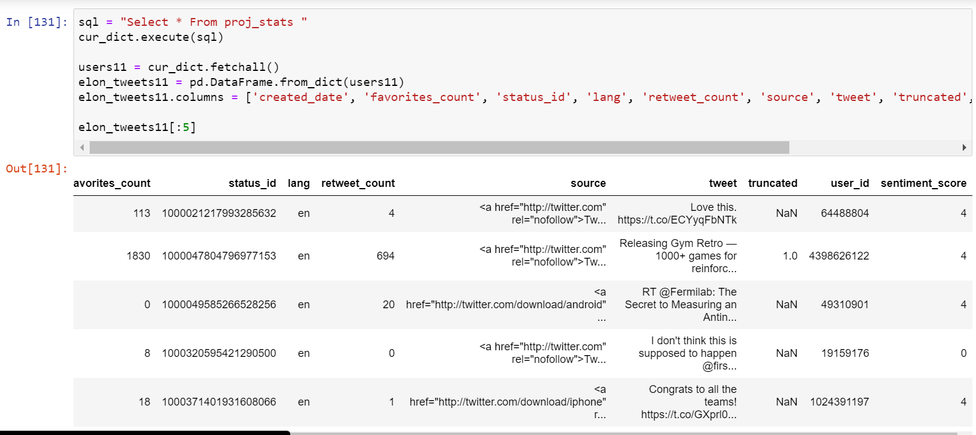
With the previous query we added the Sentiment score to the Table in the Database

Slide 41
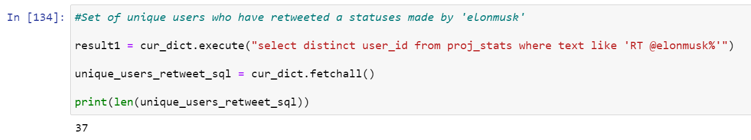
Analysis and Insights
Set of unique users who have retweeted statuses by Elon Musk:
37 unique user retweeted his statuses.

Slide 42
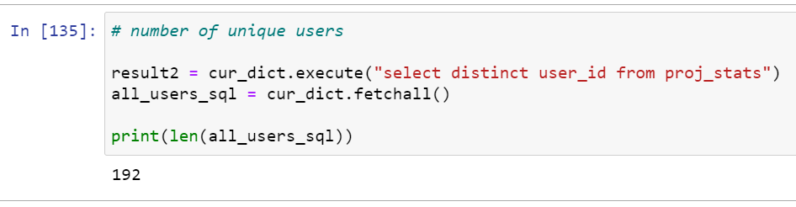
Number of Unique Users in the data set
Analysis and Insights

Slide 43
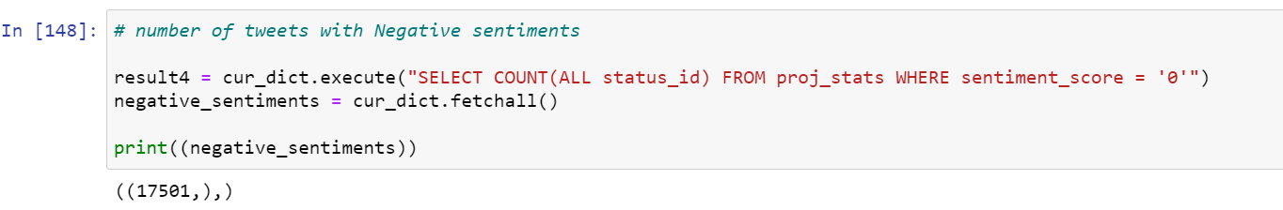
Number of tweets with Negative sentiments
Analysis and Insights
.

Slide 44
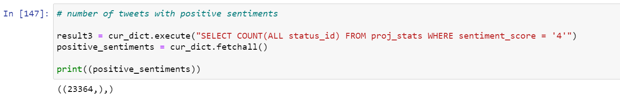
Number of tweets with positive sentiments
Analysis and Insights
.

Slide 45
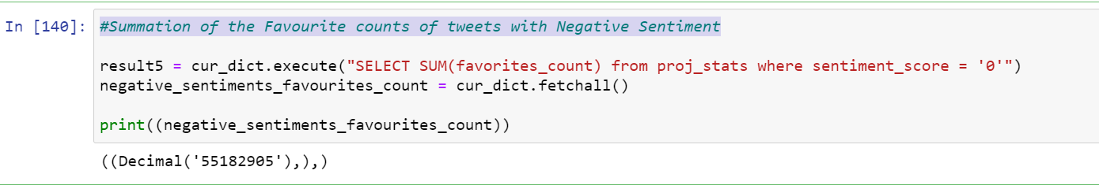
Total number of the Favorite counts of tweets with Negative Sentiment
Analysis and Insights
.
.

Slide 46
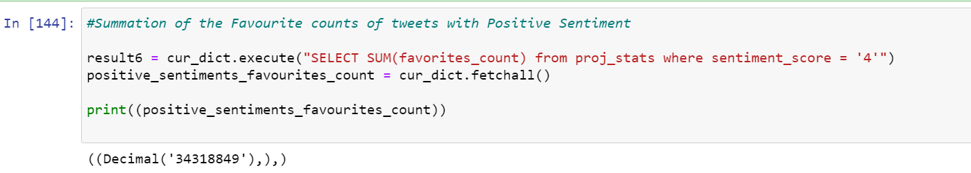
Summation of the Favorite counts of tweets with Positive Sentiment
Analysis and Insights
.

Slide 47
Insight
We did analysis on the data, and concluded that although Negative tweets are lesser in number compared to positive tweets, their favorite count is 55,182,905, while that of positive tweets is 34,318,849.
This is almost 21 million more than positive tweets.

Slide 48
References:
https://www.kaggle.com/kazanova/sentiment140
https://www.kdnuggets.com/2019/04/text-preprocessing-nlp-machine-learning.html
https://github.com/Gunjan933
https://stackoverflow.com/questions/47980656/wordcloud-is-not-defined-python3-6
https://www.upgrad.com/blog/sentiment-analysis-projects-topics-for-beginners/
https://github.com/abdulfatir/twitter-sentiment-analysis
https://stackoverflow.com/questions/15138973/how-to-get-the-number-of-the-most-frequent-value-in-a-column
https://github.com/dominusmi/Twitter-Sentiment-Analysis-Project
https://monkeylearn.com/blog/sentiment-analysis-of-twitter/
https://github.com/kb22/Twitter-Sentiment-Analysis

Slide 49
References:
https://stackoverflow.com/questions/45759966/counting-unique-values-in-a-column-in-pandas-dataframe-like-in-qlik
https://pandas.pydata.org/docs/getting_started/intro_tutorials/03_subset_data.html
https://github.com/sharmaroshan/Twitter-Sentiment-Analysis
https://github.com/merb92/Twitter-Sentiment-Analysis
https://stackoverflow.com/questions/26476668/frequency-plot-in-python-pandas-dataframe
https://medium.com/swlh/tweet-sentiment-analysis-using-python-for-complete-beginners-4aeb445604
https://github.com/ayushoriginal/Sentiment-Analysis-Twitter
https://stackoverflow.com/questions/16476924/how-to-iterate-over-rows-in-a-dataframe-in-pandas
https://github.com/xiamx/awesome-sentiment-analysis

Slide 50
Thank you!

